Slide 1


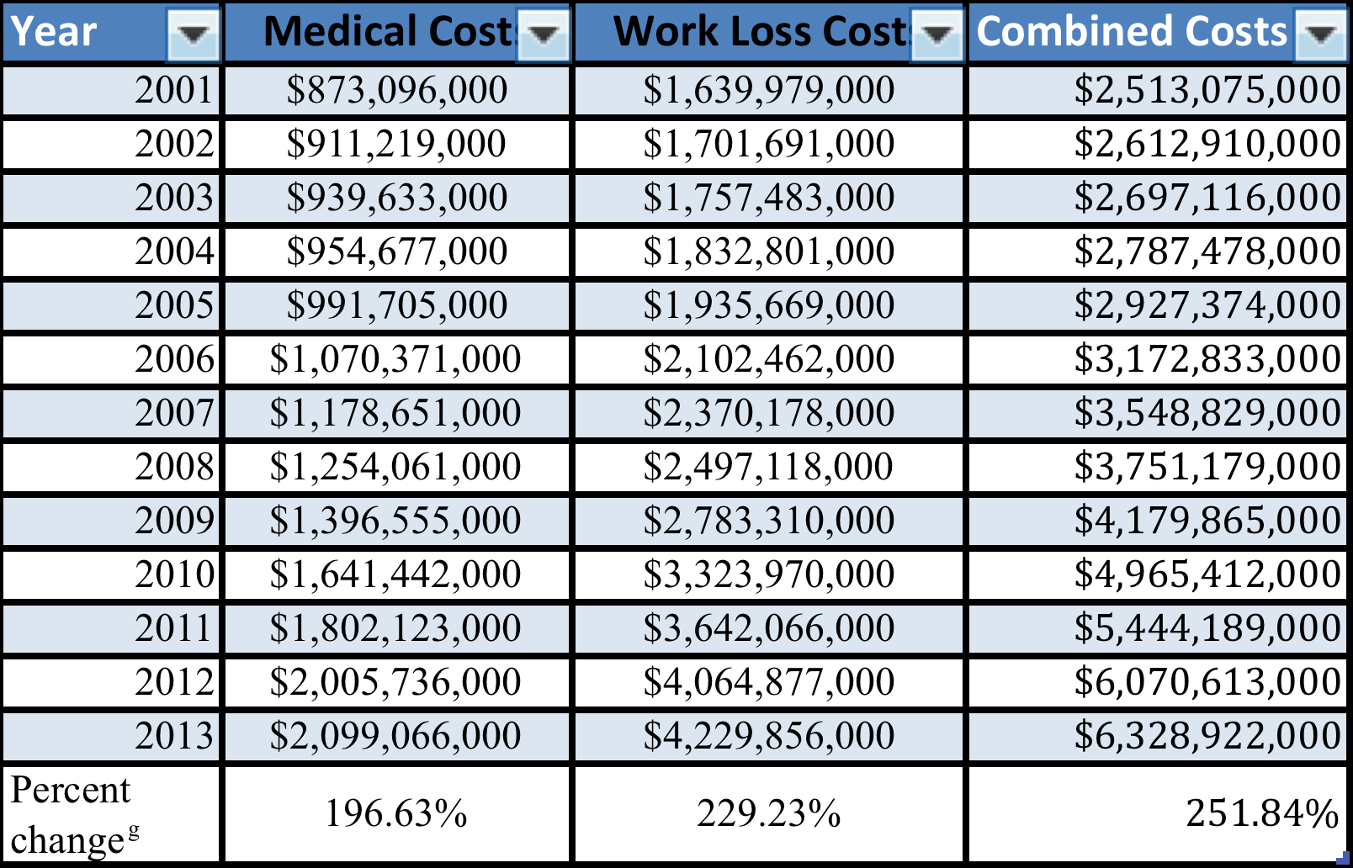

Human Trafficking and Health Needs in Sacramento
Vincent Lee, Julia Magaña, M.D. and Bryn Mumma, M.D., M.A.S.
UC Davis School of Medicine. Department of Emergency Medicine, University of California, Davis
BACKGROUND
RESULTS
CONCLUSIONS
Human trafficking (HT), defined by the United Nations in 2000, is “the recruitment, transportation, transfer, harboring or receipt of persons by the threat or use of kidnapping, force, fraud, deception or coercion, or by the giving or receiving of unlawful payments or benefits to achieve the consent of a person having control over another person, and for the purpose of sexual exploitation or forced labor.”¹ Because of the nature of this crime, it is difficult to truly know how many individuals are involved. Emergency healthcare providers are often in the unique position to identify and provide resources for those patients who are identified as trafficked persons. Yet, due to the lack of understanding of the landscape in which these patients live, the ability to identify and assist in a safe way is limited.²
Table 1: Interview themes with illustrative quotations.
Figure 1: Flowchart of ED response to HT
Theme |  | Illustrative Quotations
Healthcare Needs
 | Mental Health Needs | “My mental health is most important because it can't be "fixed". It's something I have to always deal with.” “I'd have really bad night terrors, and couldn't have one restful night of sleep for almost 6 months, until I went to therapy.”
 | Healthcare While Being Trafficked | “Getting healthcare while I was in the life was a controlled situation by my abuser. My whereabouts had to be known at all times.” “I would go to the ED …but I would go on the way to doing something. I'd have to cut out and go really quickly and then hide or discard the papers.” “If I needed to see a doctor I had to beg him to let me go. When I became pregnant he wouldn't let me get prenatal care.”
Trafficking Victims in the Emergency Department
 | Feeling Judged | “When I went to the ED for domestic violence, I felt judged for my choices. Like people didn’t understand what I was experiencing. I would usually just barge out if I felt like I was being treated bad.” “…I was treated like I did something wrong. Like, oh you must have been on drugs and got beat up and that’s why you’re here.” “…I saw a social worker in the ER...she sounded like she was judging me for running away…asking really sharp questions. I just shut down.
 | Lack of ED Screening | “They could have probed more about why I was there or how I ended up there. Look, when you're in the life, you're not going to go to the police station to get away. But you will go to the ER. In my opinion, if you're going to the ER, even a little bit of you is ready to get out of the life” “The staff there helped me with my medical stuff, but never asked enough about why I was there. They should be trained how to notice red flags, bruised eyes, if someone is afraid and stuff. They should have known what resources to offer because I never heard about [local human trafficking agencies]. If I had, I may have left sooner.” “If I had been asked [appropriate screening] questions, I would have been more up front about my situation.” “I didn’t know that I could talk about what was going on with me because I felt like it was so rushed to treat me medically and go on to the next patient.”
 | Advice for ED Providers and Staff | “Ask more questions about sex trafficking. More specific questions, not in an interrogating way but in a compassionate way.” “Talk to your patients instead of coming in and out of the room quickly and just giving medications. If you talk to them they might feel more comfortable and tell you what's really going on.” “Learn what to look for and signs of someone who is being trafficked. Don't be afraid to ask questions and dig a little deeper. If someone is going to the ED they're probably getting tired of being in the life and want to get out soon. They may not know how or what their options are or that they have a choice and don't have to live in the life.”
Social Service Provider Perspectives
 | Clients’ use of the ED and Planned Parenthood | “…when they’re in the life, usually they go to planned parenthood…or from the emergency room.” “When people are being trafficked or deep in the life they’re only getting as needed care for something that’s gone wrong. That may be help through planned parenthood, emergency room.”
 | Advice for ED Providers and Staff | “…know what your existing resources are…if this is not your area of expertise…refer out!” “I think they should know about resources, trauma…and complex PTSD.” “[they should] focus on connecting with the person instead of rescuing the person… instead of thinking because we’ve identified this young woman who clearly has a pimp waiting for her that we’re somehow going to in that moment change that.”
Positive Screen, Patient Accepts Help
Before HT Patient Arrives
Patient Arrives
-Connect with HT resources
-Self-educate regarding HT resources
-Create cards with HT resources
-Display signs in public areas with HT resources
-Prioritize trauma-informed care
-Screen for human trafficking
-Provide nonjudgmental, compassionate care
Positive Screen, Patient Refuses Help
-Offer resources
-Present hospital as a safe place to return when patient is ready and able to leave the life
Survivors of human trafficking commonly come into contact with medical providers while they’re in the life. We identified areas of improvement in the emergency department and elsewhere in the healthcare system. Future studies should further identify effective interventions.
Social service providers specializing in human trafficking encourage emergency department providers to contact them when patients are positively screened for human trafficking and accept services.
OBJECTIVE
We seek to gather a more comprehensive understanding of the characteristics and medical and psychosocial needs of individuals in Sacramento who are or were being trafficked. In this way, we hope to offer the best services possible to a particularly vulnerable population living in our Sacramento community.
Interviewee Demographics
REFERENCES
7 survivors of human trafficking were interviewed, ranging in age from 19 to 36, with 86% self-identifying as female. 6 social service providers representing 4 different agencies were interviewed.
were interviewed reported visiting an emergency department while being trafficked. Reasons for visiting the emergency department included
pregnancy concerns, assault, and sexual assault. Interviewees stated that providers and staff could have been more helpful by screening more for trafficking. Interviewees reported that receiving resources in healthcare settings would have been helpful while they were being trafficked, including general and contact information for human trafficking-focused social service agencies, signs displayed on hospital walls, and safety planning for when trafficking victims are ready to leave the life.
1. International Protocol to Prevent, Suppress, and Punish Trafficking in Persons, especially Women and Children. UNCJIN
2. Zimmerman C, Oram S, Borland R, et al. Meeting the health needs of trafficked persons. BMJ. 2009 Aug 26;339:b3326.
METHODS
Survivors of human trafficking were selected for interviews by social service providers working in trafficking-related organizations. Social service providers with direct contact with human trafficking survivors were interviewed regarding the experiences of their clients. Interviews were transcribed and analyzed for thematic content, including a combination of pre-specified themes derived from interview questions as well as de novo themes that emerged from the data.
Healthcare Needs
ACKNOWLEDGEMENTS
Year | Medical Costs | Work Loss Costs | Combined Costs
2001 | $873,096,000 | $1,639,979,000 | $2,513,075,000
2002 | $911,219,000 | $1,701,691,000 | $2,612,910,000
2003 | $939,633,000 | $1,757,483,000 | $2,697,116,000
2004 | $954,677,000 | $1,832,801,000 | $2,787,478,000
2005 | $991,705,000 | $1,935,669,000 | $2,927,374,000
2006 | $1,070,371,000 | $2,102,462,000 | $3,172,833,000
2007 | $1,178,651,000 | $2,370,178,000 | $3,548,829,000
2008 | $1,254,061,000 | $2,497,118,000 | $3,751,179,000
2009 | $1,396,555,000 | $2,783,310,000 | $4,179,865,000
2010 | $1,641,442,000 | $3,323,970,000 | $4,965,412,000
2011 | $1,802,123,000 | $3,642,066,000 | $5,444,189,000
2012 | $2,005,736,000 | $4,064,877,000 | $6,070,613,000
2013 | $2,099,066,000 | $4,229,856,000 | $6,328,922,000
Percent change^{g} | 196.63% | 229.23% | 251.84%
Most interviewees identified mental health among their greatest healthcare concerns. When asked about specific barriers in accessing healthcare, many stated that transportation was a concern.
Special acknowledgements to Dr. Bryn Mumma and Dr. Julia Magaña of the UC Davis Department of Emergency Medicine, as well as Community Against Sexual Harm, Opening Doors, City of Refuge, and other organizations focused on human trafficking and survivors.
Special thanks to the Alpha Omega Alpha Honor Society for funding this research.
Year | Medical Costs | Work Loss Costs | Combined Costs
2001 | $873,096,000 | $1,639,979,000 | $2,513,075,000
2002 | $911,219,000 | $1,701,691,000 | $2,612,910,000
2003 | $939,633,000 | $1,757,483,000 | $2,697,116,000
2004 | $954,677,000 | $1,832,801,000 | $2,787,478,000
2005 | $991,705,000 | $1,935,669,000 | $2,927,374,000
2006 | $1,070,371,000 | $2,102,462,000 | $3,172,833,000
2007 | $1,178,651,000 | $2,370,178,000 | $3,548,829,000
2008 | $1,254,061,000 | $2,497,118,000 | $3,751,179,000
2009 | $1,396,555,000 | $2,783,310,000 | $4,179,865,000
2010 | $1,641,442,000 | $3,323,970,000 | $4,965,412,000
2011 | $1,802,123,000 | $3,642,066,000 | $5,444,189,000
2012 | $2,005,736,000 | $4,064,877,000 | $6,070,613,000
2013 | $2,099,066,000 | $4,229,856,000 | $6,328,922,000
Percent change^{g} | 196.63% | 229.23% | 251.84%
Year | Medical Costs | Work Loss Costs | Combined Costs
2001 | $873,096,000 | $1,639,979,000 | $2,513,075,000
2002 | $911,219,000 | $1,701,691,000 | $2,612,910,000
2003 | $939,633,000 | $1,757,483,000 | $2,697,116,000
2004 | $954,677,000 | $1,832,801,000 | $2,787,478,000
2005 | $991,705,000 | $1,935,669,000 | $2,927,374,000
2006 | $1,070,371,000 | $2,102,462,000 | $3,172,833,000
2007 | $1,178,651,000 | $2,370,178,000 | $3,548,829,000
2008 | $1,254,061,000 | $2,497,118,000 | $3,751,179,000
2009 | $1,396,555,000 | $2,783,310,000 | $4,179,865,000
2010 | $1,641,442,000 | $3,323,970,000 | $4,965,412,000
2011 | $1,802,123,000 | $3,642,066,000 | $5,444,189,000
2012 | $2,005,736,000 | $4,064,877,000 | $6,070,613,000
2013 | $2,099,066,000 | $4,229,856,000 | $6,328,922,000
Percent change^{g} | 196.63% | 229.23% | 251.84%
Year | Medical Costs | Work Loss Costs | Combined Costs
2001 | $873,096,000 | $1,639,979,000 | $2,513,075,000
2002 | $911,219,000 | $1,701,691,000 | $2,612,910,000
2003 | $939,633,000 | $1,757,483,000 | $2,697,116,000
2004 | $954,677,000 | $1,832,801,000 | $2,787,478,000
2005 | $991,705,000 | $1,935,669,000 | $2,927,374,000
2006 | $1,070,371,000 | $2,102,462,000 | $3,172,833,000
2007 | $1,178,651,000 | $2,370,178,000 | $3,548,829,000
2008 | $1,254,061,000 | $2,497,118,000 | $3,751,179,000
2009 | $1,396,555,000 | $2,783,310,000 | $4,179,865,000
2010 | $1,641,442,000 | $3,323,970,000 | $4,965,412,000
2011 | $1,802,123,000 | $3,642,066,000 | $5,444,189,000
2012 | $2,005,736,000 | $4,064,877,000 | $6,070,613,000
2013 | $2,099,066,000 | $4,229,856,000 | $6,328,922,000
Percent change^{g} | 196.63% | 229.23% | 251.84%
Year | Medical Costs | Work Loss Costs | Combined Costs
2001 | $873,096,000 | $1,639,979,000 | $2,513,075,000
2002 | $911,219,000 | $1,701,691,000 | $2,612,910,000
2003 | $939,633,000 | $1,757,483,000 | $2,697,116,000
2004 | $954,677,000 | $1,832,801,000 | $2,787,478,000
2005 | $991,705,000 | $1,935,669,000 | $2,927,374,000
2006 | $1,070,371,000 | $2,102,462,000 | $3,172,833,000
2007 | $1,178,651,000 | $2,370,178,000 | $3,548,829,000
2008 | $1,254,061,000 | $2,497,118,000 | $3,751,179,000
2009 | $1,396,555,000 | $2,783,310,000 | $4,179,865,000
2010 | $1,641,442,000 | $3,323,970,000 | $4,965,412,000
2011 | $1,802,123,000 | $3,642,066,000 | $5,444,189,000
2012 | $2,005,736,000 | $4,064,877,000 | $6,070,613,000
2013 | $2,099,066,000 | $4,229,856,000 | $6,328,922,000
Percent change^{g} | 196.63% | 229.23% | 251.84%
Theme |  | Illustrative Quotations
Healthcare Needs
 | Mental Health Needs | “My mental health is most important because it can't be "fixed". It's something I have to always deal with.” “In the beginning I'd have really bad night terrors, and couldn't have one restful night of sleep for almost 6 months, until I went to therapy.”
 | Transportation as a Barrier to Healthcare Access | “My biggest challenge right now is finding a ride or getting on the bus.” “Transportation is always hard. Getting to the dr. on the bus sometimes takes all day and if I have to get my kids from school, then I won't have enough time.”
 | Healthcare While Being Trafficked | “Getting healthcare while I was in the life was a controlled situation by my abuser. My whereabouts had to be known at all times.” “I would go to the ED if I had any scares for STDs or pregnancy. But I would go on the way to be doing something. I'd have to cut out and go really quickly and then hide or discard the papers.” “My trafficker would make appointments for me with his doctor and go with me. I could have said no, but I was intimidated and afraid of making him suspicious.” “If I needed to see a doctor I had to beg him to let me go. When I became pregnant he wouldn't let me get prenatal care.” “I mostly received care from Planned Parenthood here in Sacramento…”
Trafficking in the Emergency Department
 | Feeling Judged | “When I went to the ED for domestic violence, I felt judged for my choices. Like people didn’t understand what I was experiencing. I would usually just barge out if I felt like I was being treated bad.” “…I was treated like I did something wrong. Like, oh you must have been on drugs and got beat up and that’s why you’re here.” “…I saw a social worker in the ER...she sounded like she was judging me for running away. Just asking really sharp questions. I just shut down.
 | ED Screening for Human Trafficking | “They could have probed more about why I was there or how I ended up there. Look, when you're in the life, you're not going to go to the police station to get away. But you will go to the ER. In my opinion, if you're going to the ER, even a little bit of you is ready to get out of the life” “The staff there helped me with my medical stuff, but never asked enough about why I was there. They should be trained how to notice red flags, bruised eyes, if someone is afraid and stuff. They should have known what resources to offer because I never heard about [local human trafficking agencies]. If I had, I may have left sooner.” “If I had been asked [appropriate screening] questions, I would have been more up front about my situation.” “I didn’t know that I could talk about what was going on with me because I felt like it was so rushed to treat me medically and go on to the next patient.”
 | Resources in the ED | “I wouldn't have taken any pamphlets but maybe a 1800 number or a small card. Something I can stuff in my pocket and hide from my pimp.” “I might have been receptive to a number, but probably wouldn't have read a pamphlet.” “[Safety planning]…what can you do to keep me safe once I leave here? What's the long term plan to keep me safe and with my daughter?”
 | Advice for ED Providers and Staff | “Ask more questions about sex trafficking. More specific questions, not in an interrogating way but in a compassionate way.” “Talk to your patients instead of coming in and out of the room quickly and just giving medications. If you talk to them they might feel more comfortable and tell you what's really going on.” “Learn what to look for and signs of someone who is being trafficked. Don't be afraid to ask questions and dig a little deeper. If someone is going to the ED they're probably getting tired of being in the life and want to get out soon. They may not know how or what their options are or that they have a choice and don't have to live in the life.”
Social Service Provider Perspectives
 | Client Demographics | “For the most part we see predominantly African American women and girls.” “The majority are African American, are women, are between the ages of 19-35.” “Percentage wise over half are generally African American, with the remainder, white, some Hispanic. For the most part we see women who have been sex trafficked…”
 | Client Use of the ED | “…when they’re in the life, usually they go to planned parenthood…or from the emergency room.” “When people are being trafficked or deep in the life they’re only getting as needed care for something that’s gone wrong. That may be help through planned parenthood, emergency room.”
 | Advice for ED Providers and Staff | “…know what your existing resources are…if this is not your area of expertise…refer out!” “I think they should know about resources, trauma…and complex PTSD.” “[they should] focus on connecting with the person instead of rescuing the person… instead of thinking because we’ve identified this young woman who clearly has a pimp waiting for her that we’re somehow going to in that moment change that.”
Emergency Department Experiences
All survivors of human trafficking who

